Slide 1

INTERNSHIP REPORT
Name: Harshith Boddu
Register Number: 192210516

Slide 2
TABLE OF CONTENTS
Introduction
Company Overview
Internship Objectives
Work Responsibilities
Challenges and Solutions
Skills Gained and Knowledge Acquired
Contribution to the Organization
Conclusion

Slide 3
INTRODUCTION
About me.
Purpose of the internship
Duration and location
I,Harshith Boddu, a student of B.Tech in the Department of Computer Science and Engineering solemnly affirm that the internship experience documented in this report reflects my direct involvement in a formal organizational setting, actively engaged in industry-relevant operations.
To entrust with tasks and responsibilities that were integral to the company’s ongoing functions. The insights and observations included herein are a true representation of the work culture, technical exposure, and professional interactions I encountered at JBK IT Technologies.
Duration: : August,05,2025 – Sep,05,2025
.

Slide 4
COMPANY OVERVIEW
About the Organization.
Name of the Company: JBK IT Technologies
Nature of Business/Industry Sector: Technology Services and Digital Solutions
Brief History & Overview: JBK IT Technologies is an Technology Services and Digital Solutions and internship platform that provides practical training opportunities for students in various technical domains such as Web Development, Data Science, Artificial Intelligence, and Software Development.
Location(s): Hyderabad , India.
Services Offered: Web Development, Software Solutions, IT Services.
The department I worked in.
Internship Title/Designation: Web Development Intern
Department/Division Assigned: web Projects Division

Slide 5
INTERNSHIP OBJECTIVES
Primary objectives of internship.
Hoped to achieve during the internship.
Gain practical exposure to Web development workflows
Contribute to ongoing web development projects and understand deployment practices and team collaboration.
Participated in web development tasks and assisted in creating web pages.
Worked with HTML, CSS, and JavaScript to design and develop simple web applications.

Slide 6
WORK RESPONSIBILITIES
Projects I worked on or assisted with.
My main tasks and responsibilities.
Simple Website Development: Built a basic website using HTML, CSS, and JavaScript.
Calculator Web Application: Created a basic calculator using HTML, CSS, and JavaScript.
API-Based Web Application: Integrated external APIs to fetch and display real-time data within web applications.
Developed web pages using HTML, CSS, and JavaScript.
Designed and implemented basic web applications like a calculator.
Tested and debugged website code to ensure proper functionality.
Collaborated with team members and shared project work through GitHub.

Slide 7
CHALLENGES AND SOLUTIONS
Challenges I faced during my internship.
Learning new web development concepts.
Fixing coding errors.
Managing time to finish tasks.
How I addressed or overcame them.
Practiced coding and improved understanding of web development.
Debugged errors and tested the code carefully.
Planned tasks properly to complete work on time.

Slide 8
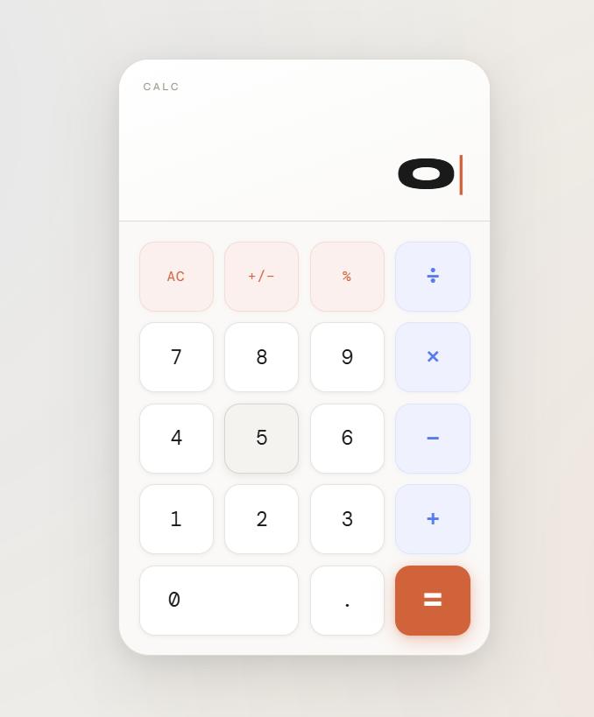
SKILLS GAINED AND KNOWLEDGE ACQUIRED
Tools, software, or methodologies I learned.
The professional and personal skills I developed.
Pictures if any..
Programming Languages: HTML, CSS, JavaScript
Tools: VS Code, GitHub.
Technologies: Basic Web Development
Improved web development and coding skills.
Learned problem-solving and debugging.
Improved teamwork and communication skills.

Slide 9

Website Pages

Slide 10
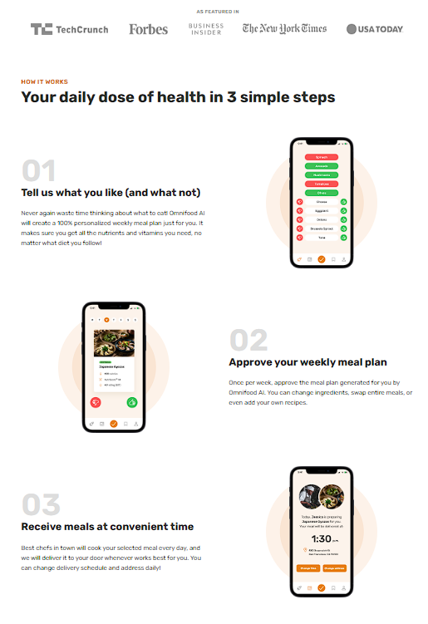
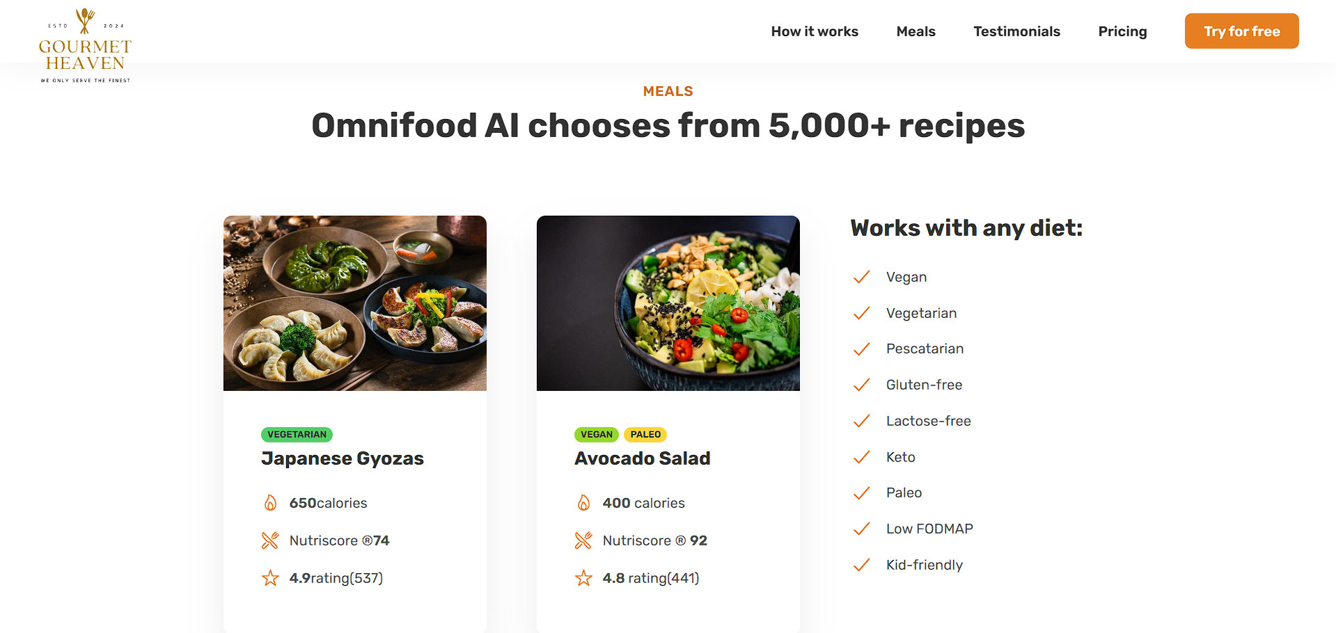
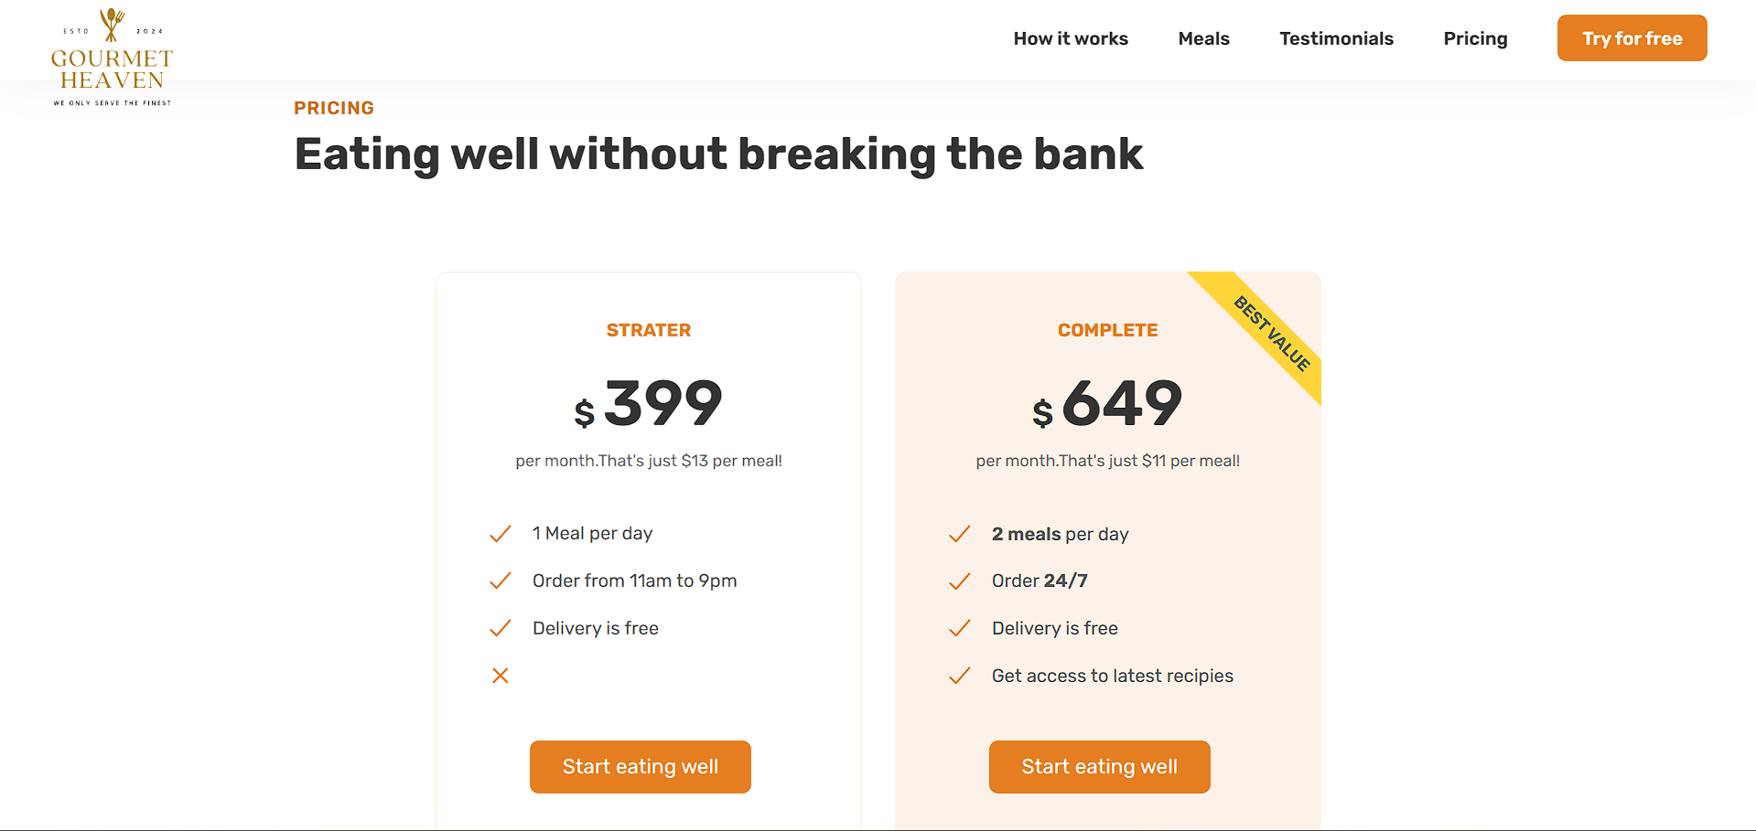
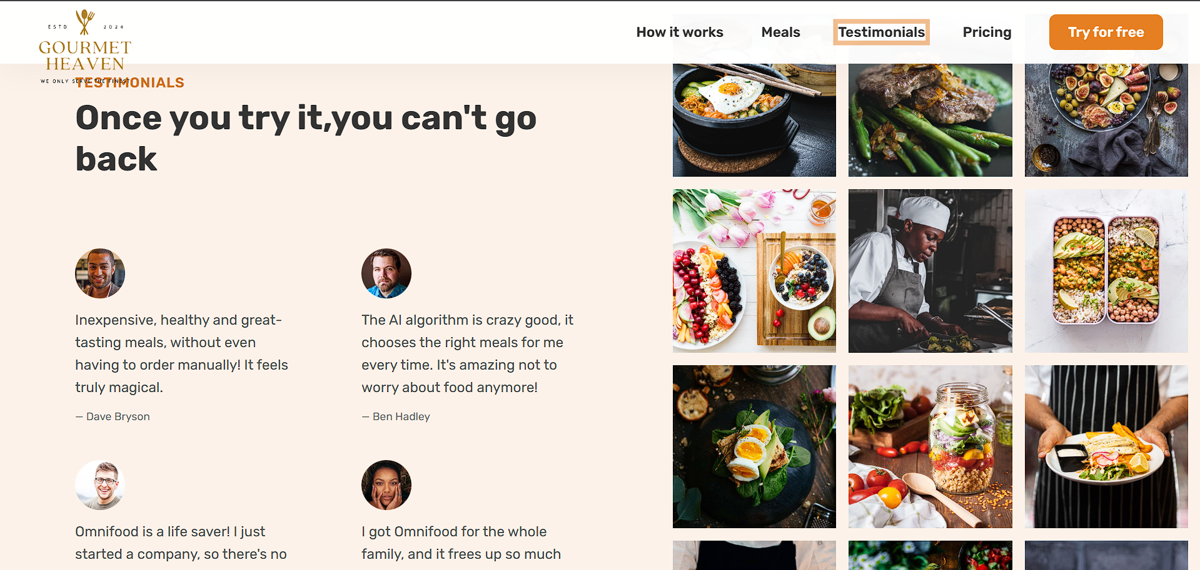
Website Pages

Slide 11
CONTRIBUTION TO THE ORGANIZATION
How my work added value to the organization.
Feedback received from my supervisor or team.
Helped in developing Omnifood web applications for project tasks.
Created reusable code that supported faster development.
Actively participated in team discussions and project improvements.
Received appreciation for fast learning ability, consistency, and active contribution to web development tasks and project goals. The supervisor noted a clear improvement in practical Web development skills and professionalism during the internship.

Slide 12
CONCLUSION
Summarization of internship experience:
My overall experience at JBK IT Technologies was both enriching and valuable. Being part of the Web Development team helped me understand real-world development practices and allowed me to apply my academic knowledge to practical web development projects.
Reflect on how the internship aligned with my career goals:
This internship helped me understand web development and real industry work. The hands-on experience with web projects and teamwork improved my technical skills and supported my goal of building a career in the software and web development field.

Slide 13
THANK YOU

